Slide 1

Unit 1: Introduction and Financial Goals
What are your financial goals for the future?

Slide 2
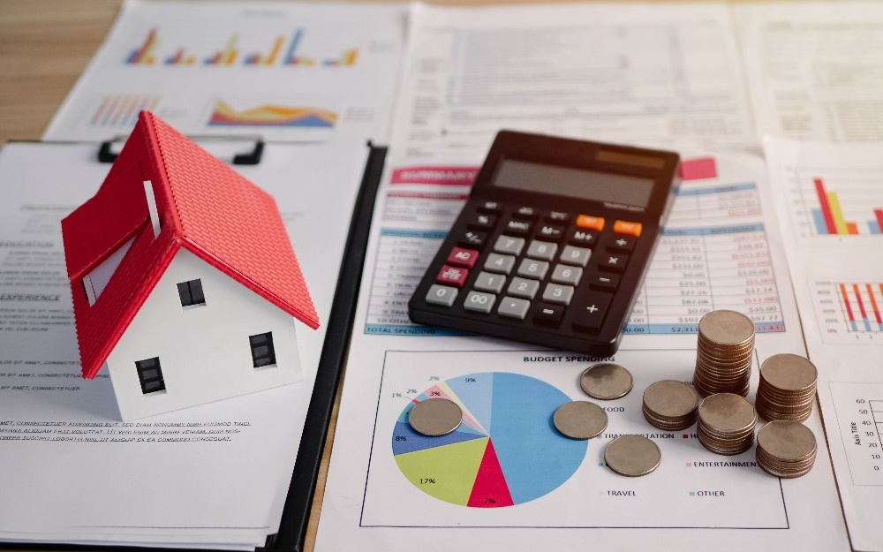
Discussion
Preview: What do you know about financial literacy?

Slide 3
Reasons for Managing Your Money
Good Mental Health
Increased Enjoyment of Life

Slide 4

Think, Pair, Share
How is managing your money related to good mental health?

Slide 5
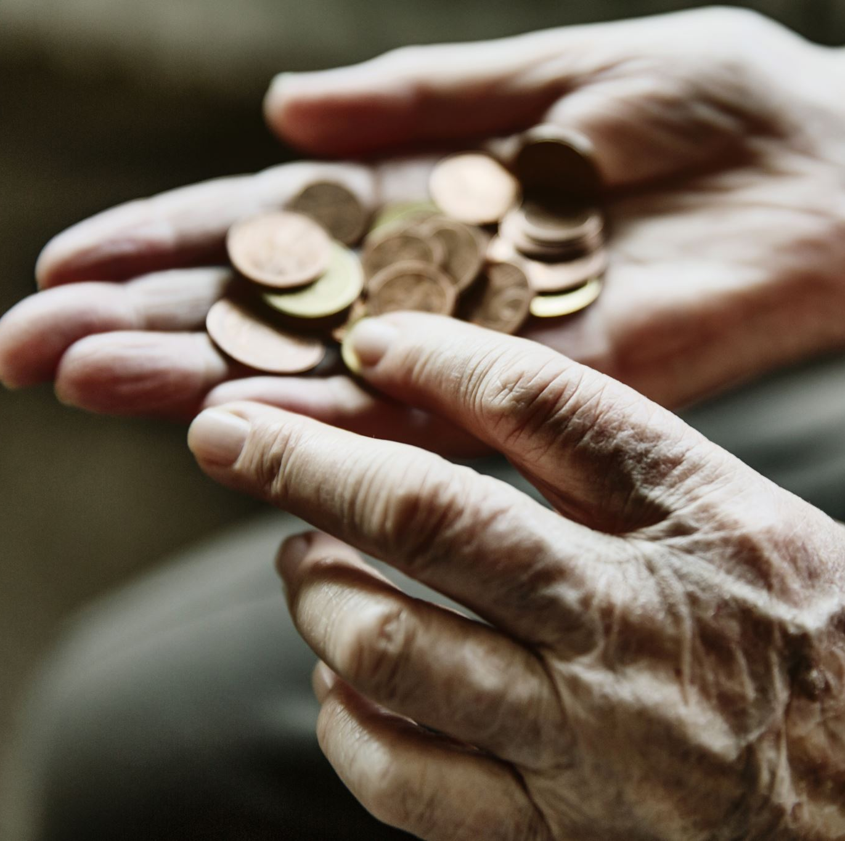
Money Problems
Stress
Anxiety
Fatigue
Sleeplessness

Slide 6
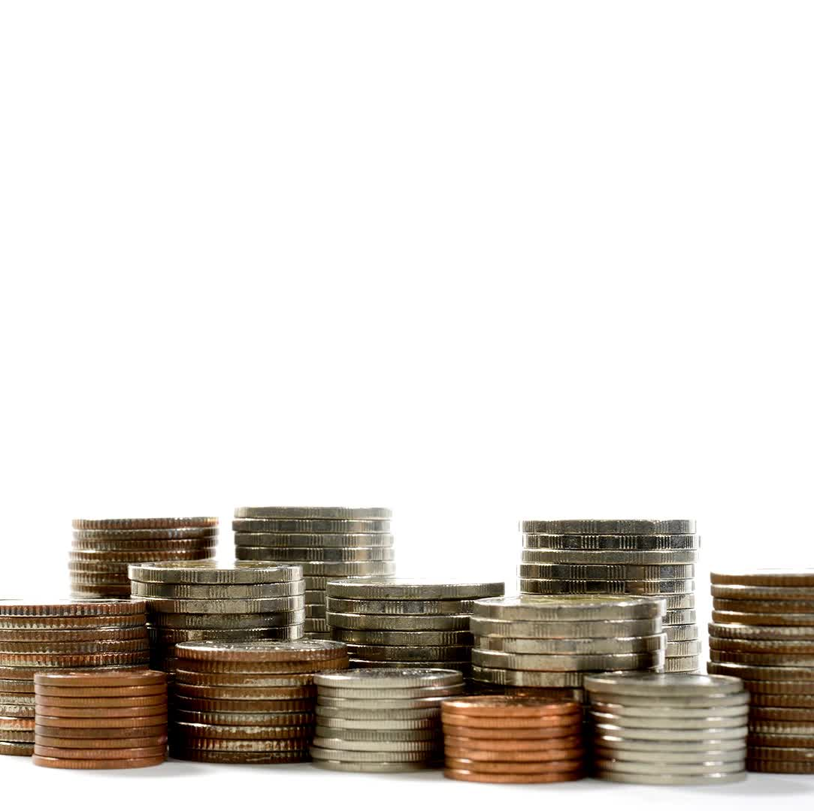
Good Money Management
Increases Happiness and Enjoyment of Life

Slide 7

Stand up if you agree:
Money cannot buy happiness.

Slide 8
Does Money Guarantee Happiness?
Many rich and famous people are not happy
The problem is that the more we have, the more we want.

Slide 9

Overspending Results
Increased debt
Inability to save

Slide 10
Group Discussion
Psychologists agree that having enough money for basic needs is important to happiness. Besides money, what other factors are important for achieving happiness in life?

Slide 11

How to be happy
Having enough money to cover the basics.
Understanding and using your personal strengths.
Choosing a satisfying career.
Positive thinking
Good relationships with friends and family
Other ideas?

Slide 12

Checklist for Success
Think about how managing your money can help you to minimize anxiety and enjoy life.
Find a career that matches your personal strengths and provides a good income.
Make a list of your financial goals.
Create and use a budget.
Limit your expenses.
Develop the habit of saving money.
Learn about investments to build wealth.
Create a financial plan.

Slide 13
The video answers these questions
How do people become wealthy?
How is stress management related to financial literacy
What is the best way to control my spending?
How can I save money to make a large purchase such as a car or home?
What is a financial plan and why should I have one?

Slide 14





The video answers these questions:
Why should I invest my money?
What are some investments?
What is a good return on investments?
What is compound interest?
How can I avoid too much debt?

Slide 15

Video: Introducing Financial Literacy

Slide 16

What does financial security mean to you? What is your vision for the future? How will you get started?
Activity: Financial Literacy Goals
Classroom Handout

